Slide 1
The Impact of Covid-19 on Suicide Rate
PROJECT 1
Group Members:
Armine Arutyunyan
Birundha Varatharajan
Ammanesi Adamu
Stan Ejiobi

Slide 2
Introduction
Covid-19, a world pandemic which broke out in late 2019 brought significant changes to the world. Despite its direct impact on sickness and mental health around the world, its effect was also felt on suicide rate.

Slide 3
Scope
The goal of this project is:
To examine the impact of Covid-19 on suicide rate. The task includes gathering information on global suicide rate from 2016 to 2021.
The information will be broken down using different strategies to identify and point out any patterns.

Slide 4
Data Source
Data was pulled form the following sources to capture suicide trends as impacted by Covid-19.
World Bank (www.worldbank.org)
kaggle(www.Kaggle.com)
The OECD (data.oecd.org)
Center For Disease and Control (www.cdc.gov)

Slide 5
Methods
Reading the file containing data on global suicide rate.
Cleaned the data
Grouped the data based on age, gender and income.
Created charts for visualization
Performed ANOVA analysis to show if xxxx

Slide 6
4 Questions to Address
Global Suicide Rate (2016 to 2020) ?
Global Suicide Rate by Age group (2016 to 2020) ?
Global Suicide Rate by Gender (2016 to 2020) ?
United States Suicide Rate (2016 to 2021) ?

Slide 7
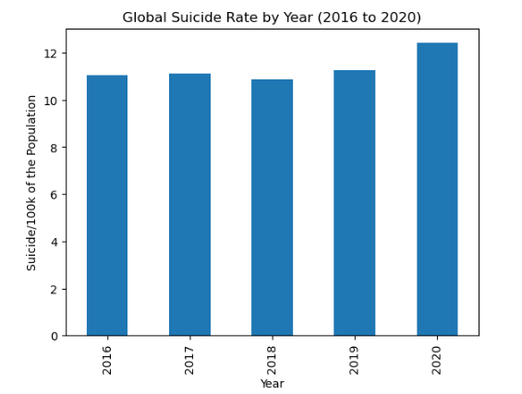
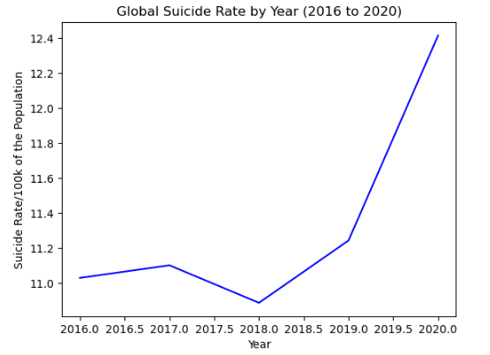
Results
A six-year span was analyzed globally from 2016 to 2020.
The suicide rate was observed to be steady from 2016 to 2019.
There was a notable increase in 2020.

Slide 8
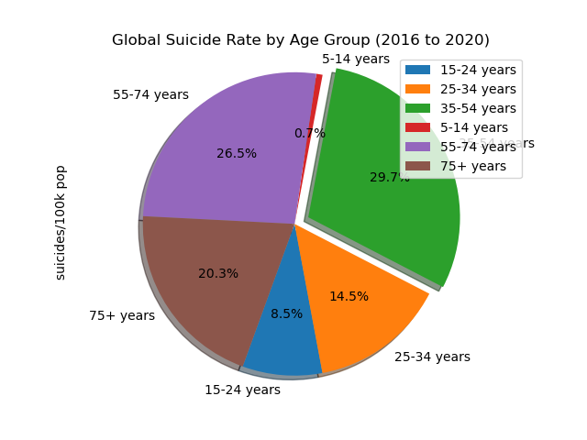
Results Continued …
By Age
A five-year span was examined globally from 2016 to 2020
The largest group to be affected were the 35 to 54 years age group.
suicides/100k pop
age
15-24 years | 3.341458
25-34 years | 5.683334
35-54 years | 11.662551
5-14 years | 0.261727
55-74 years | 10.412162
75+ years | 7.967877

Slide 9
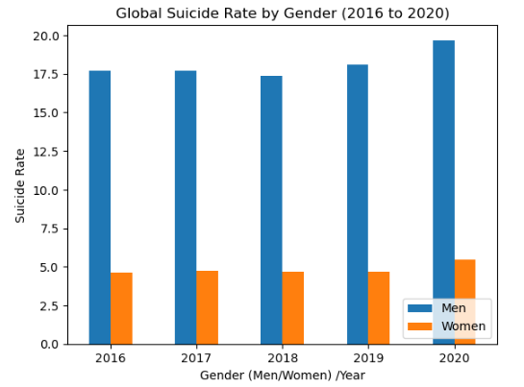
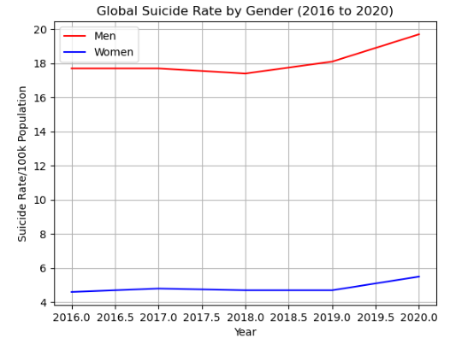
Results Continued ….
By Gender
A six-year span was examined globally from 2016 to 2020.
The suicide rate was observed to be steady from 2016 to 2019.
There was a sharp increase in 2020.

Slide 10
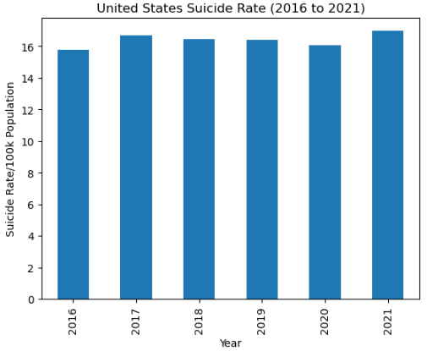
Results Continued….
United States
A six-year span was examined in the United States from 2016 to 2021.
The suicide rate increased and fluctuated from 2016 till 2019, decreased in 2020 and increased in 2021.

Slide 11
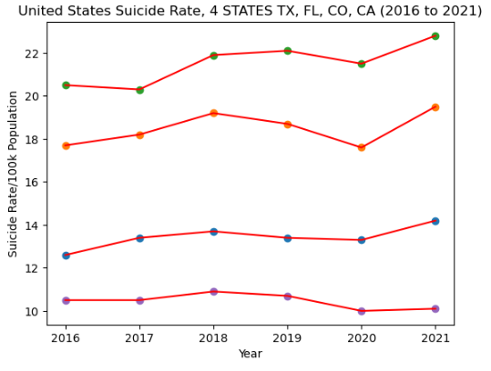
Results Continued…..
United States
4 States
TX, FL, CO, CA
A six-year span was examined in the United
The suicide rate increased and fluctuated till from 2016 till 2019, then increased from 2020 to 2021.

Slide 12
Limitations
The notable limitations to the data used include:
Only two years of covid-19 affected years. Not enough data to examine the impact of the pandemic.
Covid-19 has evolved through 2023 and its effects are still being monitored to be better understood.

Slide 13
Conclusion
Covid-19 broke out globally in late 2019.
Several studies have shown its impact on socio-economic conditions, mental health, suicide rate etc.
This study examined its impact on suicide rate globally and in the United States.
Data was pulled and analyzed to show global and United States suicide trends from 2016 to 2021.
It can be observed from the different charts that there was a slight increase in suicide rates from 2020 to 2021.

Slide 14
Conclusion Continued ……
To further analyze the data, an ANOVA test was performed on the data to check the relationship between the years and suicide rate as impacted by Covid-19.
The test returned a p-value of 0.837, showing that the impact of Covid-19 on suicide rate is statistically insignificant.
The analysis on the data does not conclusively prove that Covid-19 had an impact on suicide rate.

